Slide 1

CSE 423
Virtualization and Cloud Computing
Lecture 15
Module IV
Dr. Madhavi Dhingra

Slide 2
Contents
Developing an Economic Strategy
Exploring the Costs
Laws of cloudonomics
Economics of Cloud

Slide 3
Cloud Economics
Cloud economics is the study of the benefits, costs, and principles of cloud computing. It involves understanding: The total cost of ownership (TCO) of cloud computing, the benefits of the cloud over on-premises models, and cost optimization strategies that will maximize ROI on your cloud investment.
Cloud economics is not just about costs in actual monetary terms, but also about the opportunity costs of the cloud and the peculiarities of managing costs in a highly dynamic environment.
Economics of Cloud Computing is based on the PAY AS YOU GO method. Users/Customers must have to pay only for their way of the usage of the cloud services. It is definitely beneficial for the users. So the Cloud is economically very convenient for all. Another side is to eliminate some indirect costs which is generated by assets such as license of the software and their support. In the cloud, users can use software applications on a subscription basis without any cost because the property of the software providing service remains to the cloud provider.
Economical background of the cloud is more useful for developers in the following ways:
Pay as you go model offered by cloud providers.
Scalable and Simple.
Cloud Computing Allows:
Reduces the capital costs of infrastructure.
Removes the maintenance cost.
Removes the administrative cost.

Slide 4
Cloud Economics
What is Capital Cost?
It is cost occurred in the purchasing infrastructure or the assets that is important in the production of goods. It takes a long time to generate profit.
In the case of start-ups, there is no extra budget for the infrastructure and its maintenance. So cloud can minimizes expenses of any small organization in terms of economy. It leads to the developers can only focus on the development logic and not on the maintenance of the infrastructure.
There are three different Pricing Strategies that are introduced by Cloud Computing: Tiered Pricing, Per-unit Pricing, and Subscription-based Pricing. These are explained as following below.
Tiered Pricing: Cloud Services are offered in the various tiers. Each tier offers to fix service agreements at a specific cost. Amazon EC2 uses this kind of pricing.
Per-unit Pricing: The model is based upon the unit-specific service concept. Data transfer and memory allocation include in this model for specific units. GoGrid uses this kind of pricing in terms of RAM/hour.
Subscription-based Pricing: In this model, users are paying periodic subscription fees for the usage of the software.

Slide 5
Understanding Cloud Economics: Key Areas
1. Cloud total cost of ownership (TCO)
In cloud computing, the total cost of ownership (TCO) is the total cost of adopting, operating, and provisioning cloud infrastructure. TCO is helpful for understanding your return on investment.
Businesses have always performed TCO analysis for traditional IT infrastructure. However, performing TCO analysis for cloud computing can be challenging because the environment is inherently more complex and dynamic than on-premises environments.
Getting an accurate TCO for cloud computing means capturing the purchase price of on-premises vs. cloud solutions as well as the intangible costs of either solution. In practice, this means:
Calculating the cost of your current IT infrastructure
Estimating the total cost of cloud adoption (including migration costs)
Quantifying the intangible benefits of the cloud (You can read a step-by-step guide for calculating cloud TCO here.)
The overall goal is to achieve a lower TCO compared to on-premises infrastructure, but it can also be about justifying a higher TCO by listing the intangible benefits associated with the cloud, such as agility and greater speed to market.

Slide 6
Understanding Cloud Economics: Key Areas
2. CAPEX to OPEX switch
Cloud computing uses a different pricing model from traditional computing and this affects how businesses account for cost. The move from capital expenses (CAPEX) to operating expenses (OPEX) is a key difference, and it affects how businesses gauge profitability in the cloud.
In traditional IT environments, computing costs are predictable and relatively fixed. A business pays for the computing capacity it needs upfront and uses the capacity over time. Calculating the total cost of ownership in this setup is fairly straightforward. In contrast, cloud providers adopt a pay-as-you-go model and most services do not require any upfront commitment.
The implication is that your business will have variable cloud computing bills that depend on the services you use and how they are consumed. While this model may save your business upfront capital expenditure, it can become a huge financial suck if resources are not managed properly.
When moving to or operating in the cloud, it is important to develop and implement cloud cost optimization strategies that will help regulate your cloud costs.

Slide 7
Understanding Cloud Economics: Key Areas
3. Elasticity
With on-premises systems and traditional IT environments, there’s a cost associated with anticipating demand. Traditional IT environments are built to anticipate peaks, which means you buy and maintain excess computing capacity in anticipation of those peak days. For most businesses, that’s a significant cost for something that’s rarely — if ever — used.
Cloud computing eliminates the need for over-provisioning because you pay only for what you use. Cloud computing platforms, such as AWS, dynamically allocate resources to projects and processes, ensuring that a business has the right amount of resources it needs at any given time. This increases cost efficiency and allows businesses to optimize resource usage.
This elasticity is one of the most appealing aspects of cloud computing and a major selling point when making a case for switching to the cloud.
4. On-demand pricing
On-demand pricing is a fundamentally different economic approach to computing power. Outside of the cloud, you’d buy a fixed amount of computing capacity or a physical server that you own. But in the cloud, you switch to on-demand pricing, so your costs become elastic.
This means cloud costs can quickly spiral out of control if you are not monitoring them regularly and making data-driven decisions.

Slide 8
Economic Characteristics of Cloud
The unique characteristics of an ideal cloud technology model is mentioned below:
Scalability: Access to unlimited computer resources without thinking about the economic aspects. This feature needs planning & provisioning.
Low Entry barrier: Users can gain access to systems for small investments also; which allows the offer to access global resources to small ventures.
Flexibility: Cloud provides high economic elasticity. Users can re-size their resources based on their need. This feature allows optimizing the system & captures all possible requirements.
Utility: As cloud providers 'pay-as-you-go' model, users can match their needs & resources on an ongoing basis. This eliminates waste and added benefits of shifting risks from the client.

Slide 9
Cloud Costs Management
The overall goal of cost control and long-term cloud cost management in cloud computing like every other business is to optimize cloud cost using available financial resources, getting the most out of every corporate pound or dollar. Most people think that technology is the key to driving success in the cloud, but, in reality, it all comes down to controlling costs. Many IT teams find that their cloud costs grow less efficient as "clutter" builds up in their accounts.
For effective cost control in cloud computing services, it is quite important to analyze and manage cloud cost and leverage cloud cost management tools to help discover the cause(s) of these inefficiencies. Unplanned cloud costs are frequently the result of lack of visibility about the current consumption patterns and past trends, nonstandard deployments that come from unclear or absent development processes, poor organization, or the absence of automated deployment and configuration tools

Slide 10
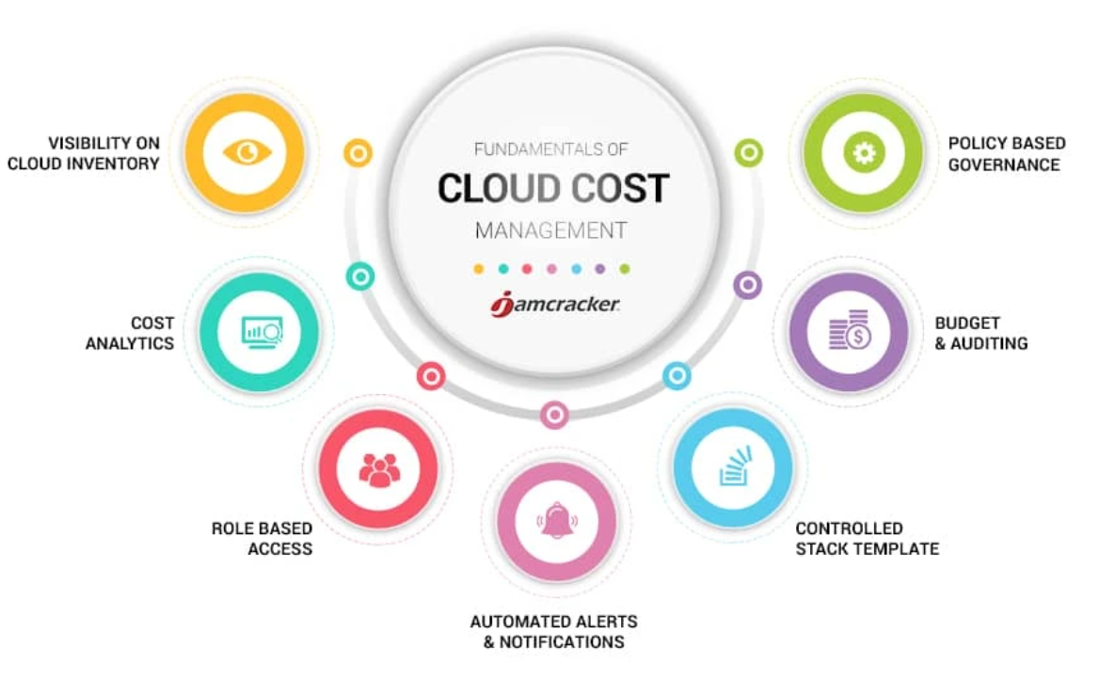
Cloud Costs Management

Slide 11
Cloud Costs Management
Visibility on Cloud Inventory
According to a recent survey of IT professionals, 75% report, they lack visibility of their cloud resources. This lack of visibility into resources in the cloud can lead to poor management of those resources. Effective cloud cost management begins with an in-depth analysis of your entire infrastructure. And if some resources in the cloud are going unused due to lack of awareness, but the organization is still paying for them, cloud costs will climb unnecessarily – and cut into the infrastructure savings and other financial benefits the cloud can bring. Admins who have access to a single pane of glass and detailed Resource Dashboards are equipped to better organize, manage, and optimize that ecosystem across all accounts, clouds, departments, and teams.
Cost Analytics
Complete visibility on the cloud services used, the actual usage patterns and trends is the first step. No matter your cloud environment, in addition to tracking what you have spent, it is important to project what you will be spending. You need consolidated as well granular details in the form of interactive graphical and tabular reports across multiple dimensions, time frames in a multi-cloud environment to correlate data for analysis and reporting against business objectives.

Slide 12
Cloud Costs Management
Role Based Access
Permit users to actively manage the infrastructure after setting an Enterprise-wide mechanism that clearly defines permissions and accessibility within the platform. Limit the data and actions visible to users by organizations and roles and identify who launched, terminated, or changed infrastructure, and what they did to take corrective action and control costs.
Controlled Stack Templates
A crucial characteristic of any DevOps team is to enable teams more autonomy over-provisioning resources without the red tape and extensive time delay of traditional IT environments Using predefined stack templates, Administrators can bake in security, network, and instance family/size configurations, so that the process of deploying instances is not only faster but aligned with the Departmental user’s roles and privileges and ensures only specific Resources are provisioned.

Slide 13
Cloud Costs Management
Automated Alerts and Notifications
Stay on top of day-to-day changes in your environment, and participate in the critical decision by sharing standard and custom built reports with details on cost, usage, performance with stakeholders. Automated alerts and notifications about authorization failures, budget overruns, cost spikes, untagged infrastructure result in increased visibility and accountability.
Policy Based Governance
Use cloud-based governance tools to track cloud usage and costs and alert administrators when the total usage for the account is greater than a certain value or when the total usage for a vendor specific product is greater than a certain value helps control cost. Schedule operational hours to automatically shut down & start virtual machines, and automated events that alert administrators on volumes that have been disassociated from Virtual machines (standalone VMs) for more than a set number of days. Based on event thresholds, remove unused and underutilized resources and avoid unnecessary waste by sizing instances so they deliver a good balance between performance and cost. Avoid cost overrun by using policies to terminate servers created to temporarily handle the massive workloads.
Budgets
Define and allocate budgets for Departments, cost centers, projects and ensure approval mechanisms to avoid cloud cost overrun by sending out alerts when thresholds are breached. Use the Showback report to chargeback Departments for their cloud usage and limit the cloud cost and use of resources. This alignment of cost with value ensures the anticipated business benefit once the cloud resources are in production.

Slide 14
Cloud Economics Laws
Cloudonomics Law #1: Utility services cost less even though they cost more.
Although utilities cost more when they are used, they cost nothing when they are not. Consequently, customers save money by replacing fixed infrastructure with Clouds when workloads are spiky, specifically when the peak-to-average ratio is greater than the utility premium.
Cloudonomics Law #2: On-demand trumps forecasting.
Forecasting is often wrong, the ability to up and down scale to meet unpredictable demand spikes allows for revenue and cost optimalities.
Cloudonomics Law #3: The peak of the sum is never greater than the sum of the peaks.
Enterprises deploy capacity to handle their peak demands. Under this strategy, the total capacity deployed is the sum of these individual peaks. However, since clouds can reallocate resources across many enterprises with different peak periods, a cloud needs to deploy less capacity.
Cloudonomics Law #4: Aggregate demand is smoother than individual.
Aggregating demand from multiple customers tends to smooth out variation. Therefore, Clouds get higher utilization, enabling better economics.
Cloudonomics Law #5: Average unit costs are reduced.
They are reduced by distributing fixed costs over more units of output. Larger cloud providers can therefore achieve economies of scale.

Slide 15
Cloud Economics Laws
Cloudonomics Law #6: Superiority in numbers.
Superiority in numbers is the most important factor in the result of a combat. Service providers have the scale to fight rogue attacks.
Cloudonomics Law #7: Space-time is a continuum.
Organizations derive competitive advantage from responding to changing business conditions faster than the competition. With Cloud scalability, for the same cost, a business can accelerate its information processing and decision-making.
Cloudonomics Law #8: Dispersion is the inverse square of latency.
Reduced latency is increasingly essential to modern applications. A Cloud Computing provider is able to provide more nodes, and hence reduced latency, than an enterprise would want to deploy.
Cloudonomics Law #9: Don’t put all your eggs in one basket.
The reliability of a system increases with the addition of redundant, geographically dispersed components such as data centers and storage arrays. Cloud Computing vendors have the scale and diversity to do so.
Cloudonomics Law #10: An object at rest tends to stay at rest.
A data center is a very large object. Private data centers tend to remain in locations for reasons such as being where the company was founded, or where they got a good deal on property or a lease. A Cloud service provider can locate greenfield sites optimally and without such limits of legacy logic.

